Slide 1
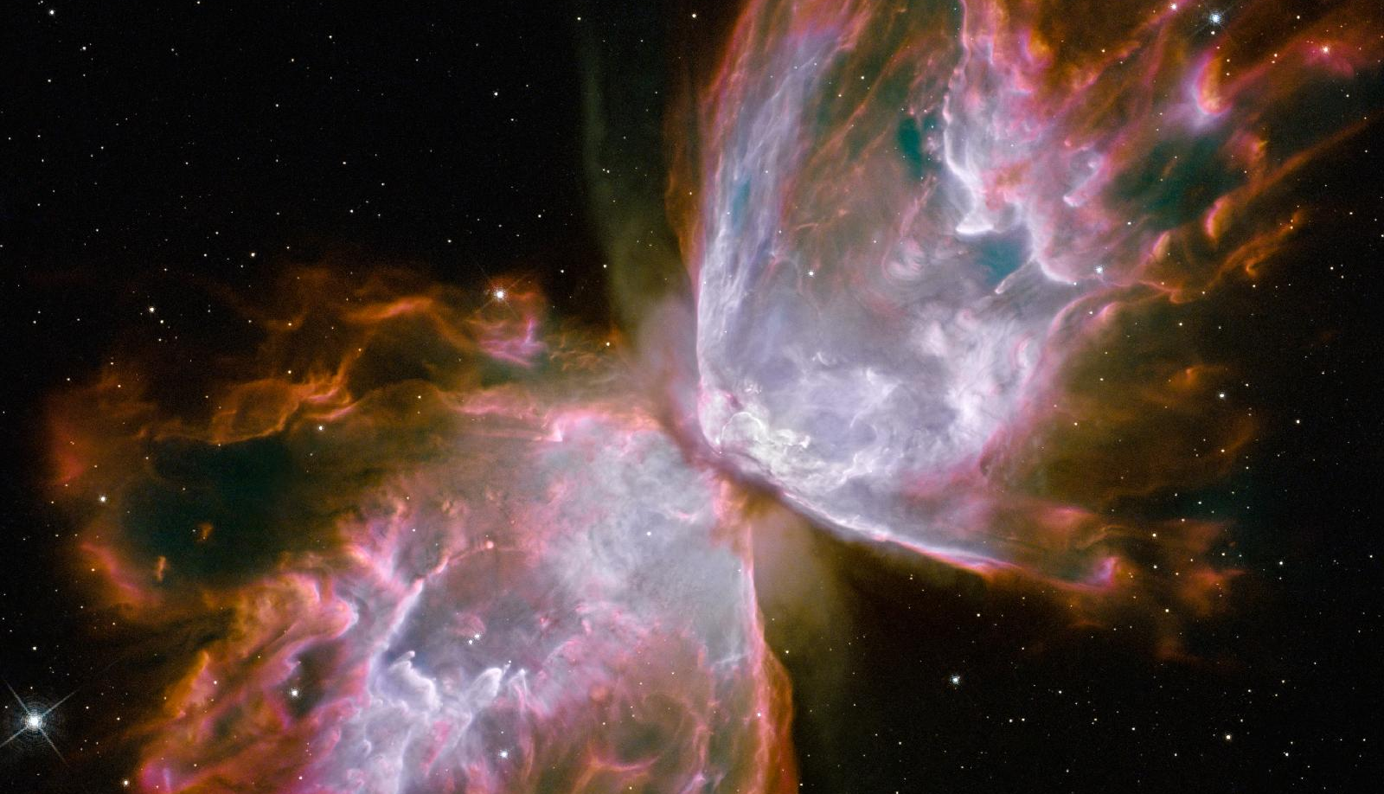
CRSS (PBGG) 8010:
Research Methods and Design in Crop Science
Jason Wallace - Fall 2026
Lesson 8
ANOVA (part 2)
NASA

Slide 2
Lecture Outline
Administrative Stuff
Review of last time
F-tests
ANOVA in R

Slide 3
Administrative Stuff
29 Sept – 1st Midterm

Slide 4
Review of last time:
ANOVA
  Sums-of-squares
  Degrees of Freedom

Slide 5
Review Exercise:
ANOVA
Run an ANOVA on this data:
Plot | Insecticide | ThripCount
001 | Fortune | 42
002 | Bugz-B-Gone | 65
003 | Eliminator | 48
004 | Bugz-B-Gone | 62
005 | Fortune | 47
006 | Eliminator | 44
ANOVA table:
 | SS | DOF | MS | F
Insecticide
Error

Slide 6
Review Exercise:
ANOVA
Run an ANOVA on this data:
Plot | Insecticide | ThripCount
001 | Fortune | 42
002 | Bugz-B-Gone | 65
003 | Eliminator | 48
004 | Bugz-B-Gone | 62
005 | Fortune | 47
006 | Eliminator | 44
ANOVA table:
 | SS | DOF | MS | F
Insecticide | 446.3 | 2 | 223.2 | 26.78
Error | 25 | 3 | 8.33

Slide 7
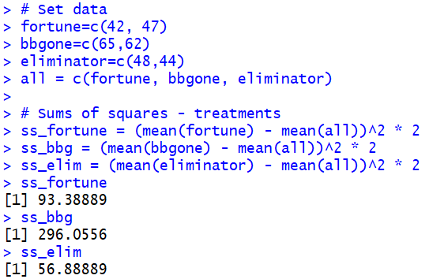
Review Exercise:
ANOVA
Setup
Treatment SS

Slide 8
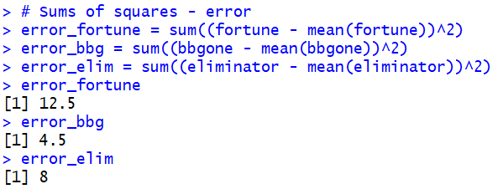
Review Exercise:
ANOVA
Error SS

Slide 9
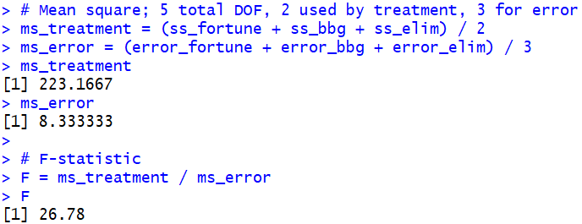
Review Exercise:
ANOVA
Mean Sq.
F

Slide 10
Questions on performing ANOVA?

Slide 11
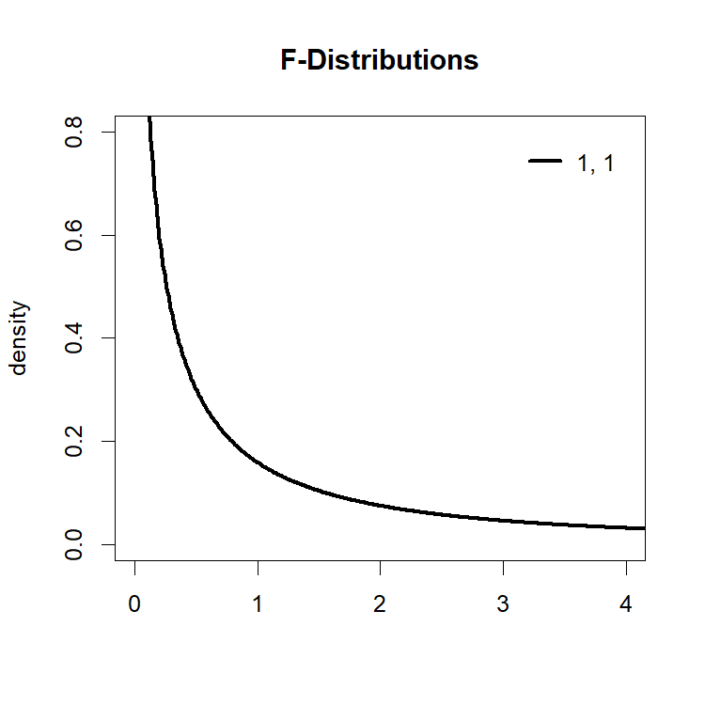
Continuing: The F distribution
The ratio of means squares follow an F distribution
  2 parameters, corresponding to DOF of numerator and denominator

Slide 12
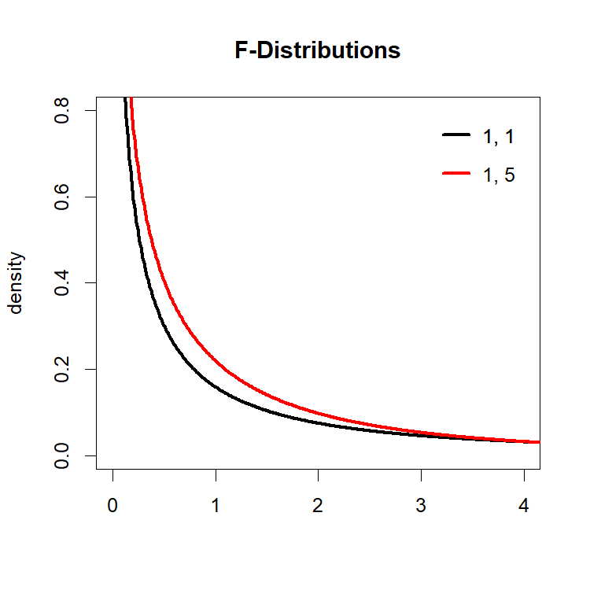
Continuing: The F distribution
The ratio of means squares follow an F distribution
  2 parameters, corresponding to DOF of numerator and denominator

Slide 13
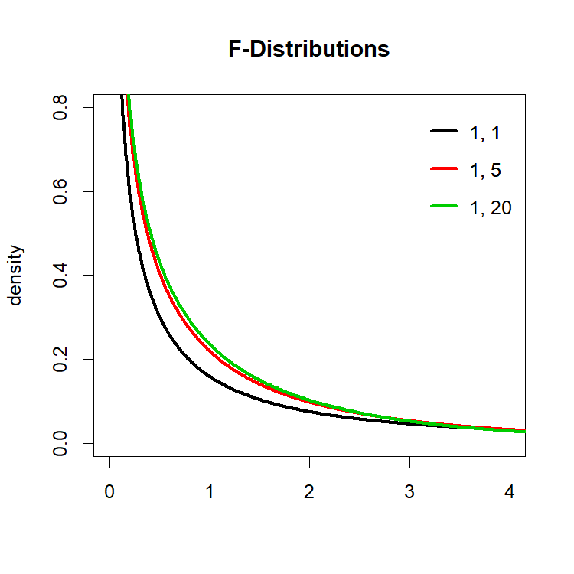
Continuing: The F distribution
The ratio of means squares follow an F distribution
  2 parameters, corresponding to DOF of numerator and denominator

Slide 14
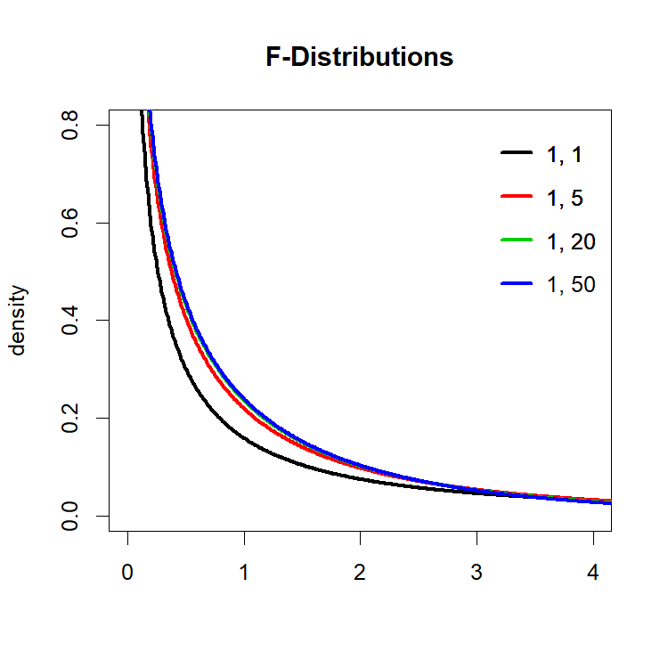
Continuing: The F distribution
The ratio of means squares follow an F distribution
  2 parameters, corresponding to DOF of numerator and denominator

Slide 15
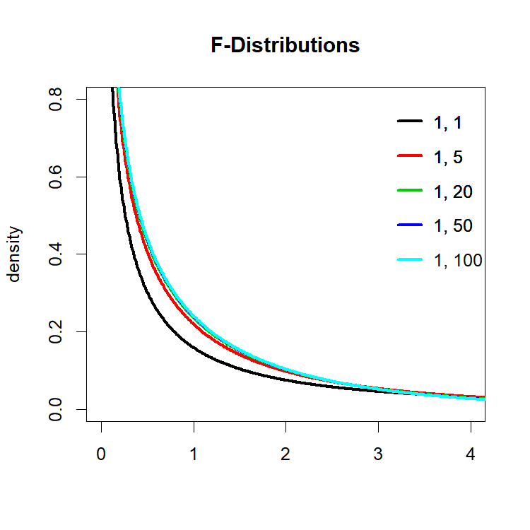
Continuing: The F distribution
The ratio of means squares follow an F distribution
  2 parameters, corresponding to DOF of numerator and denominator

Slide 16
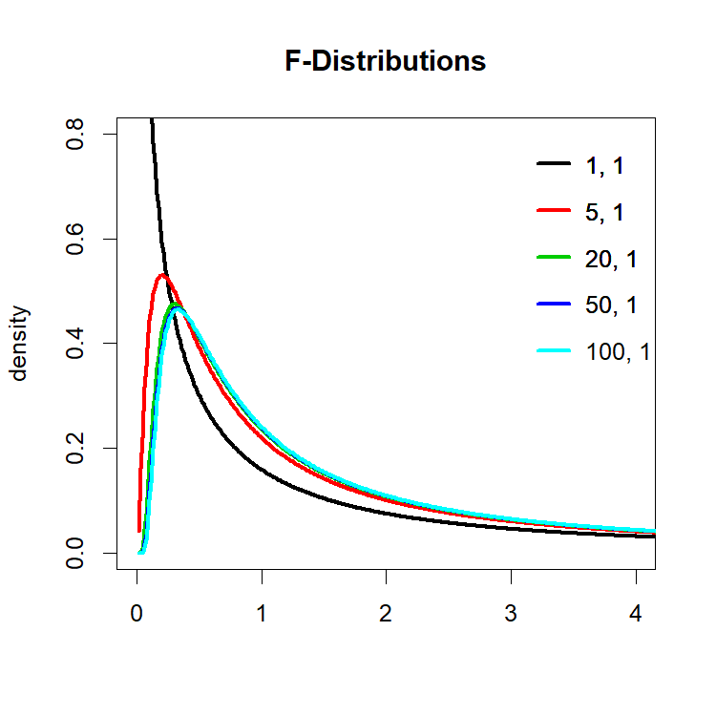
Continuing: The F distribution

Slide 17
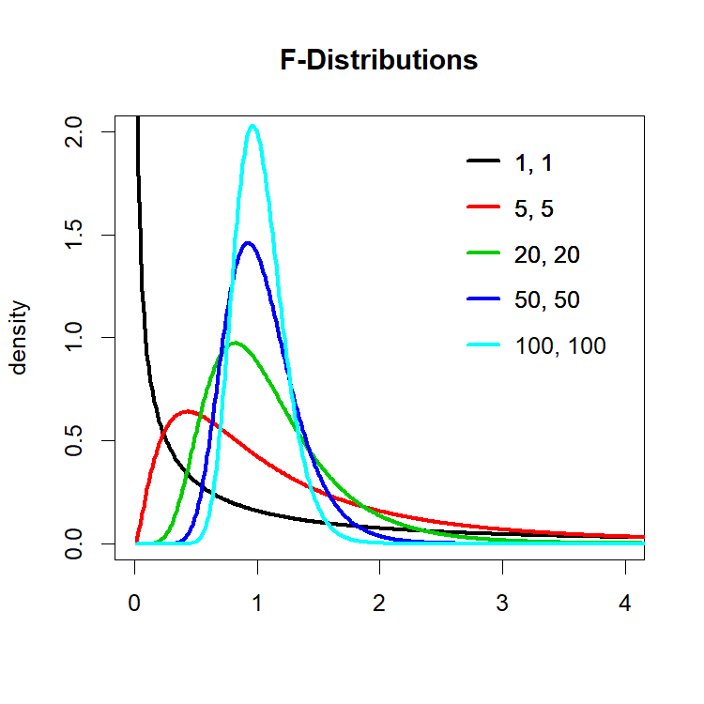
Continuing: The F distribution
Basic rule is that more DOF makes it “tighter”
For our purposes, it’s easier to see the effect of DOF on your mean square values than on the F distribution
  But notice that it starts centering around 1
Notes:
We actually don’t care about the shape of the left side of the distribution. We only care about the right-hand side.

Slide 18
Using the F distribution
Remember our ANOVA hypotheses?
  H₀: There are no differences among the groups
  H₁: There is at least one difference among the groups
If H₀ is true, then we expect our F-ratio to be around 1

Slide 19
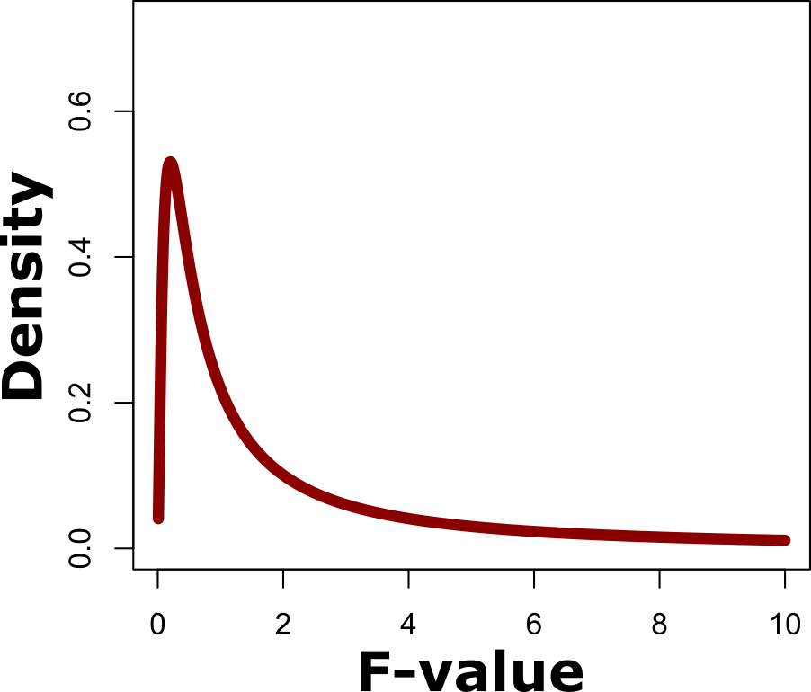
The F distribution in practice
The question we want to ask is “How likely is this F statistic if H₀ is true?”
F(5,1)
Notes:
It would be hard to get this division of degrees of freedom in a real experiment; this is mostly for demonstration

Slide 20
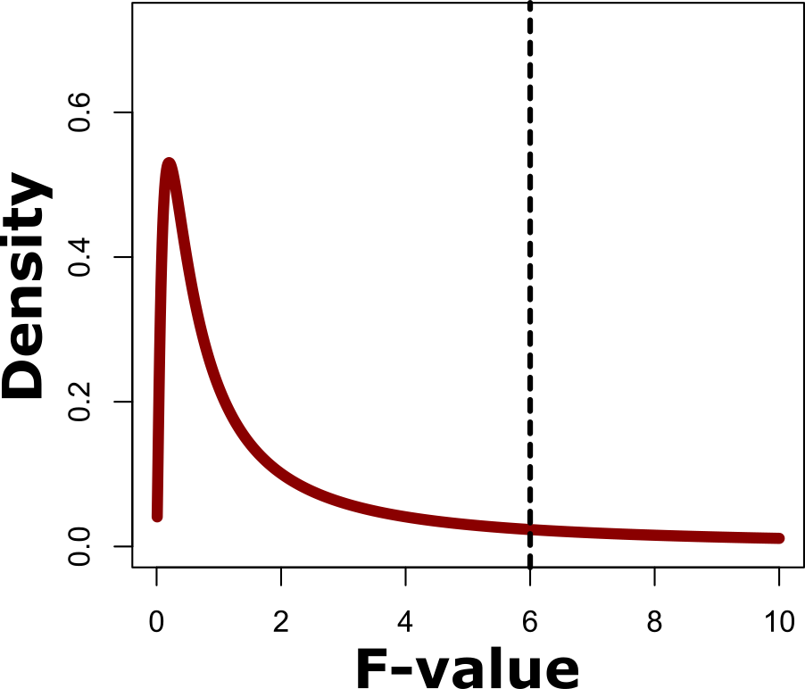
The F distribution in practice
The question we want to ask is “How likely is this F statistic if H₀ is true?”
  Example: F = 6
F(5,1)

Slide 21
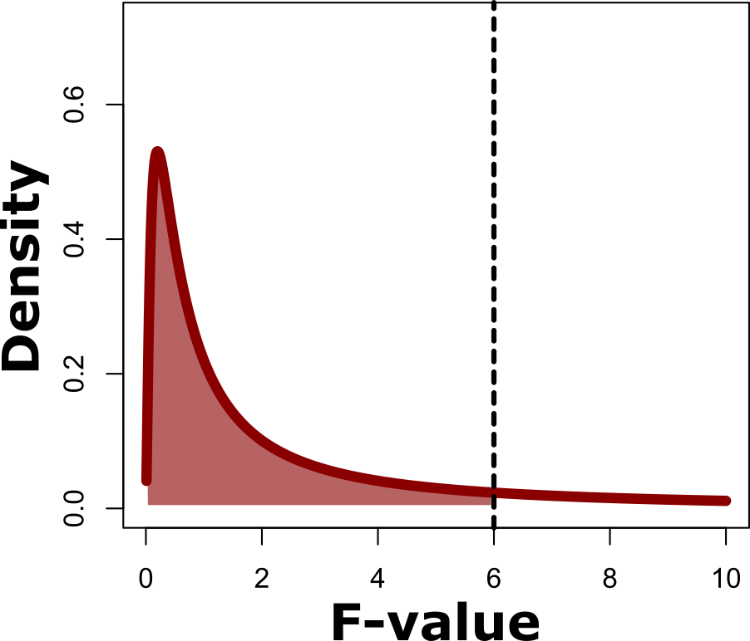
The F distribution in practice
The question we want to ask is “How likely is this F statistic if H₀ is true?”
  Example: F = 6
  p = 0.30
F(5,1)
70%
30%

Slide 22
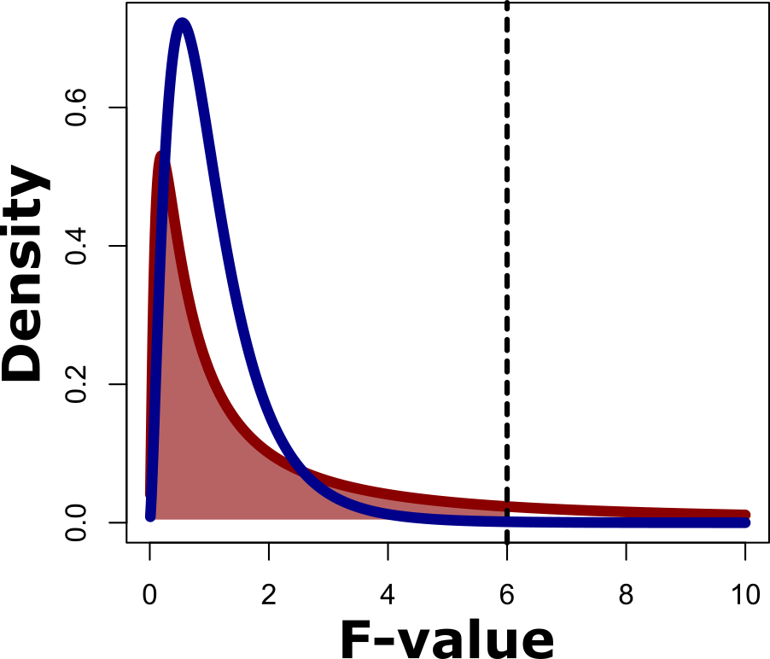
The F distribution in practice
The question we want to ask is “How likely is this F statistic if H₀ is true?”
  Example: F = 6
  p = 0.30
Now compare with more DOF for error
F(5,1)
70%
30%
F(5,20)
Notes:
Notice how much thinner the right-hand tails are on the second distribution.

Slide 23
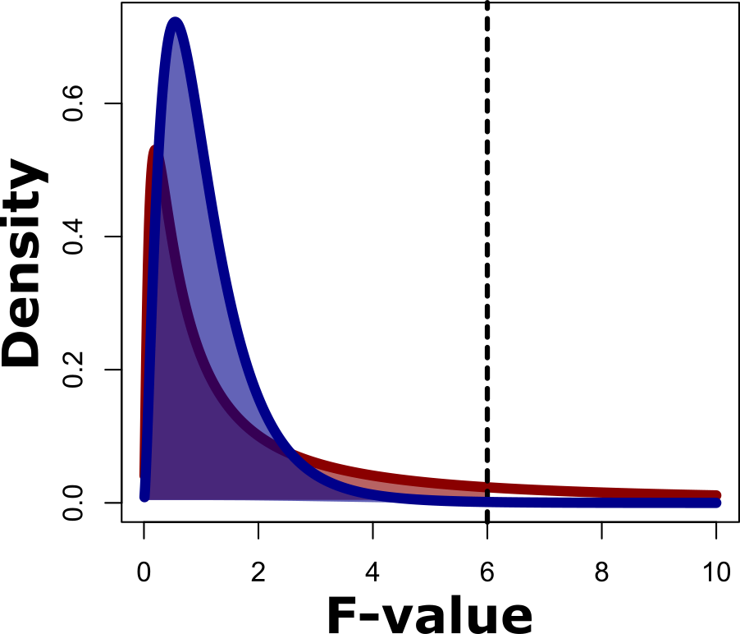
The F distribution in practice
The question we want to ask is “How likely is this F statistic if H₀ is true?”
  Example: F = 6
  p = 0.30
Now compare with more DOF for error
  p=0.002
F(5,1)
70%
30%
99.8%
0.2%
F(5,20)
Notes:
Notice how much thinner the right-hand tails are on the second distribution.

Slide 24
Take-home on F distribution
The more DOF you have for error, the smaller the F-statistic you can call as significant
  =more power
F Dist. | p<=0.05 | p<=0.01
(1,1)
(1,5)
(1,20)
(1,50)
(1,100)

Slide 25
Take-home on F distribution
The more DOF you have for error, the smaller the F-statistic you can call as significant
  =more power
F Dist. | p<=0.05 | p<=0.01
(1,1) | 161.4
(1,5) | 6.61
(1,20) | 4.35
(1,50) | 4.03
(1,100) | 3.94

Slide 26
Take-home on F distribution
The more DOF you have for error, the smaller the F-statistic you can call as significant
  =more power
F Dist. | p<=0.05 | p<=0.01
(1,1) | 161.4 | 4052
(1,5) | 6.61 | 16.26
(1,20) | 4.35 | 8.10
(1,50) | 4.03 | 7.17
(1,100) | 3.94 | 6.90

Slide 27
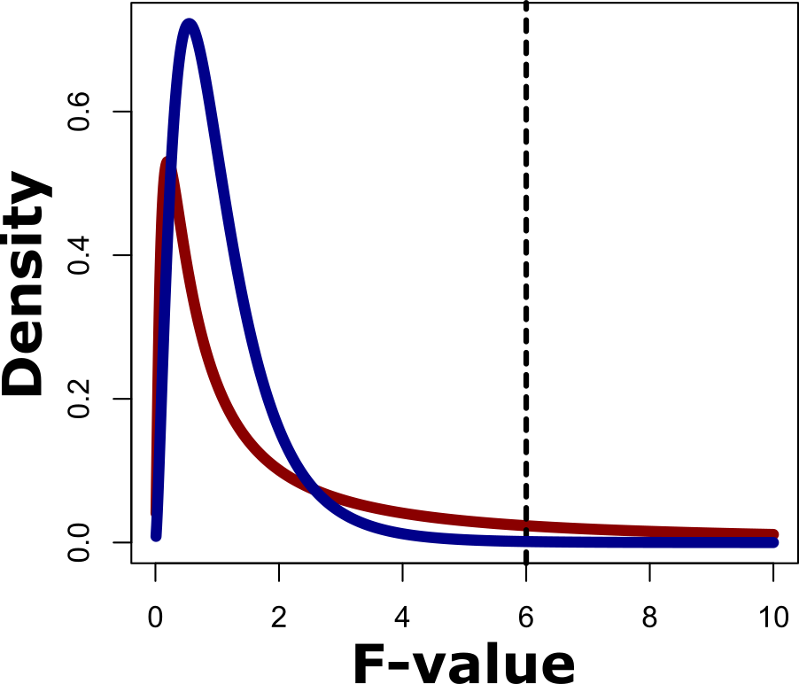
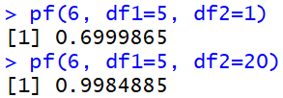
The F distribution in R
F distributions in R are handled with the _f() family of functions
  pf() – How (un)likely is this F value?
  qf() – What F value do I need to get this probability?
DOF
F(5,20)
F value
Numerator
Denominator
F(5,1)
F = 6

Slide 28
The F distribution in R
F distributions in R are handled with the _f() family of functions
  pf() – How (un)likely is this F value?
  qf() – What F value do I need to get this probability?
DOF
F(5,20)
F value
Treatment
Error
F(5,1)
F = 6

Slide 29
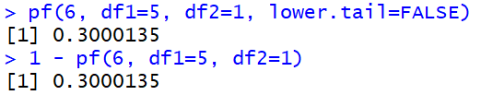
Getting p-values
By default, pf() gives you the “lower tail” probability, meaning the probability up to the F value you supply
To get actual p-values, either:
  Set the argument “lower.tail” to FALSE
  Subtract the default value from 1
Notes:
P-values are the probability of the given F value or one more extreme, which is why they need the upper tail of probability.

Slide 30
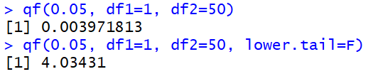
qf()
qf() is the opposite of pf()
  Takes a probability and gives you an F value out.
  Same issue with lower.tail applies

Slide 31
In-class exercise:
F-values
Finish the ANOVA table from the review by calculating the p-value
ANOVA table:
 | SS | DOF | MS | F | p
Insecticide | 446.3 | 2 | 223.2 | 26.78
Error | 25 | 3 | 8.33

Slide 32
In-class exercise:
F-values
Finish the ANOVA table from the review by calculating the p-value
ANOVA table:
 | SS | DOF | MS | F | p
Insecticide | 446.3 | 2 | 223.2 | 26.78 | 0.012
Error | 25 | 3 | 8.33
> pf(26.78, df1=2, df2=3, lower.tail=FALSE)

Slide 33
Questions on F distributions & p-values?

Slide 34
ANOVA in R
Confusingly, R has two ANOVA functions:
  aov() – Direct ANOVA (but can have issues with unbalanced data)
  anova() – ANOVA table from a fitted model. More general and useful.
We will start by using aov(), then switch to anova() once we cover linear regression

Slide 35
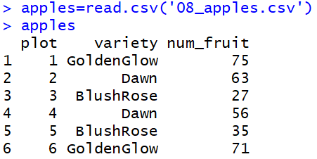
Running an ANOVA in R
It’s usually easiest to run ANOVA in R if your data is in a data frame.

Slide 36
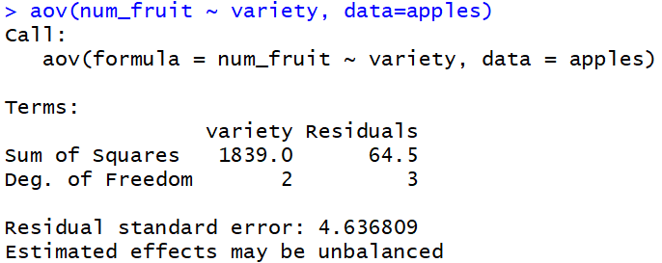
Running an ANOVA in R
After getting your data, call aov()
Function call
Dependent variable
Independent variable(s)
Where to find the data
“is a function of”
Model specification
Notes:
I’ll usually just pronounce the tidle (~) as “by”, that is, “num_fruit by variety”

Slide 37
Running an ANOVA in R
After getting your data, call aov()
Treatment
Error
Only SS and DOF
Notes:
Notice that the basic aov() call only gives Sums of Squares and DOF.
“Residuals” = “Error”

Slide 38
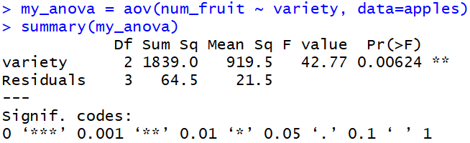
Running an ANOVA in R
The basic aov() function doesn’t give you a full ANOVA table
To get F- and p-values, run summary() on the output of aov()

Slide 39
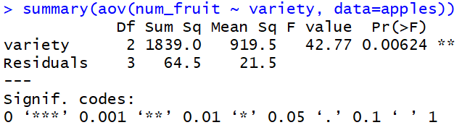
Running an ANOVA in R
The basic aov() function doesn’t give you a full ANOVA table
To get F- and p-values, run summary() on the output of aov()
  Can also do it directly instead of saving output
Notes:
I recommend doing it the other way, where you save the aov() output to a variable and then run summary on that, since if you do it this way the results are printed and then gone. If you save it in a variable, it’s around for future reference.

Slide 40
In-class exercise:
ANOVA in R
Download “08_thrips.csv” and run an ANOVA on it using R’s aov() function
  This is the same data from the review exercise
Confirm that the results match what you did by hand earlier

Slide 41
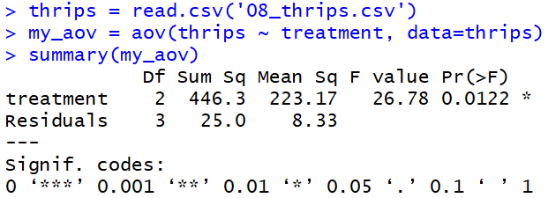
In-class exercise:
ANOVA in R

Slide 42
Questions on ANOVA in R?

Slide 43
Any last questions on statistics?
Random variables
Degrees of freedom
Distributions
ANOVA
F-tests
(We’ll cover linear regression later)

Slide 44

Homework 4: ANOVA analysis
A group is testing 3 different treatments for thrombocytopenia (low platelet count)
The file 08_platelets.csv contains data from their trial of 96 patients (24 per treatment + controls)
Run an ANOVA:
  By manually calculating the needed quantities
  By using aov() to check your math
Put your results in an R notebook (HTML report)
  Due Tuesday before class as Homework 4

